Slide 1

Closure Report
(CLOP)
Detailed CLOP Required For Release Closure
Similar to PMZ CAP

Slide 2
Release Closure Reference Documents
Technical Guidance 9: Petroleum Release Closure Categorization
  Appendix A – Petroleum Closure Checklist
RBCA Guidance
  Soil, Groundwater, and Indoor Air RBSLs
  Conversion of TPH/TEH (GRO/DRO) data to Petroleum Fractions (Section 3)

Slide 3
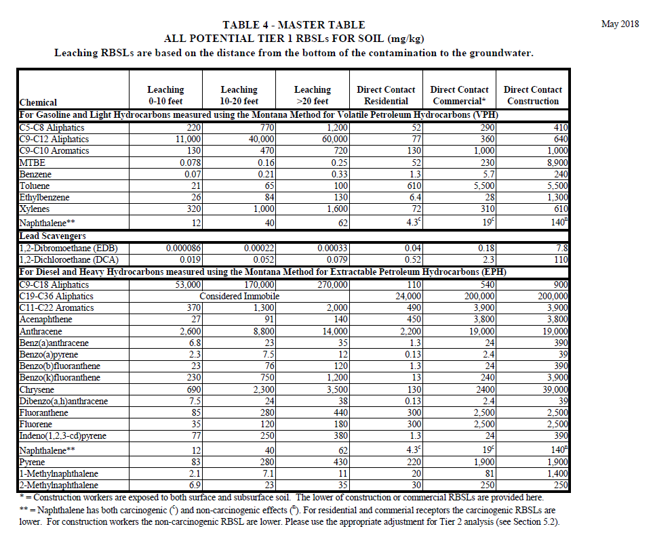

Slide 4
Common Issues
Confirmation Groundwater Sampling
Loss of Source Area Wells
Lack of DCA/EDB Groundwater Analytical Data
Lack of Adequate Confirmation Soil Sample Data
Potential VI Assessment
No Assessment of Landfarm Soil
Exceedances of Soil Direct Contact RBSLs!

Slide 5
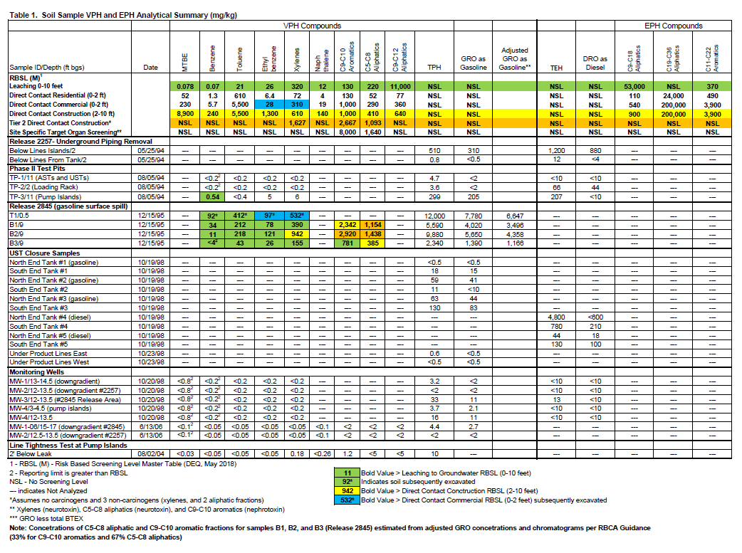

Slide 6
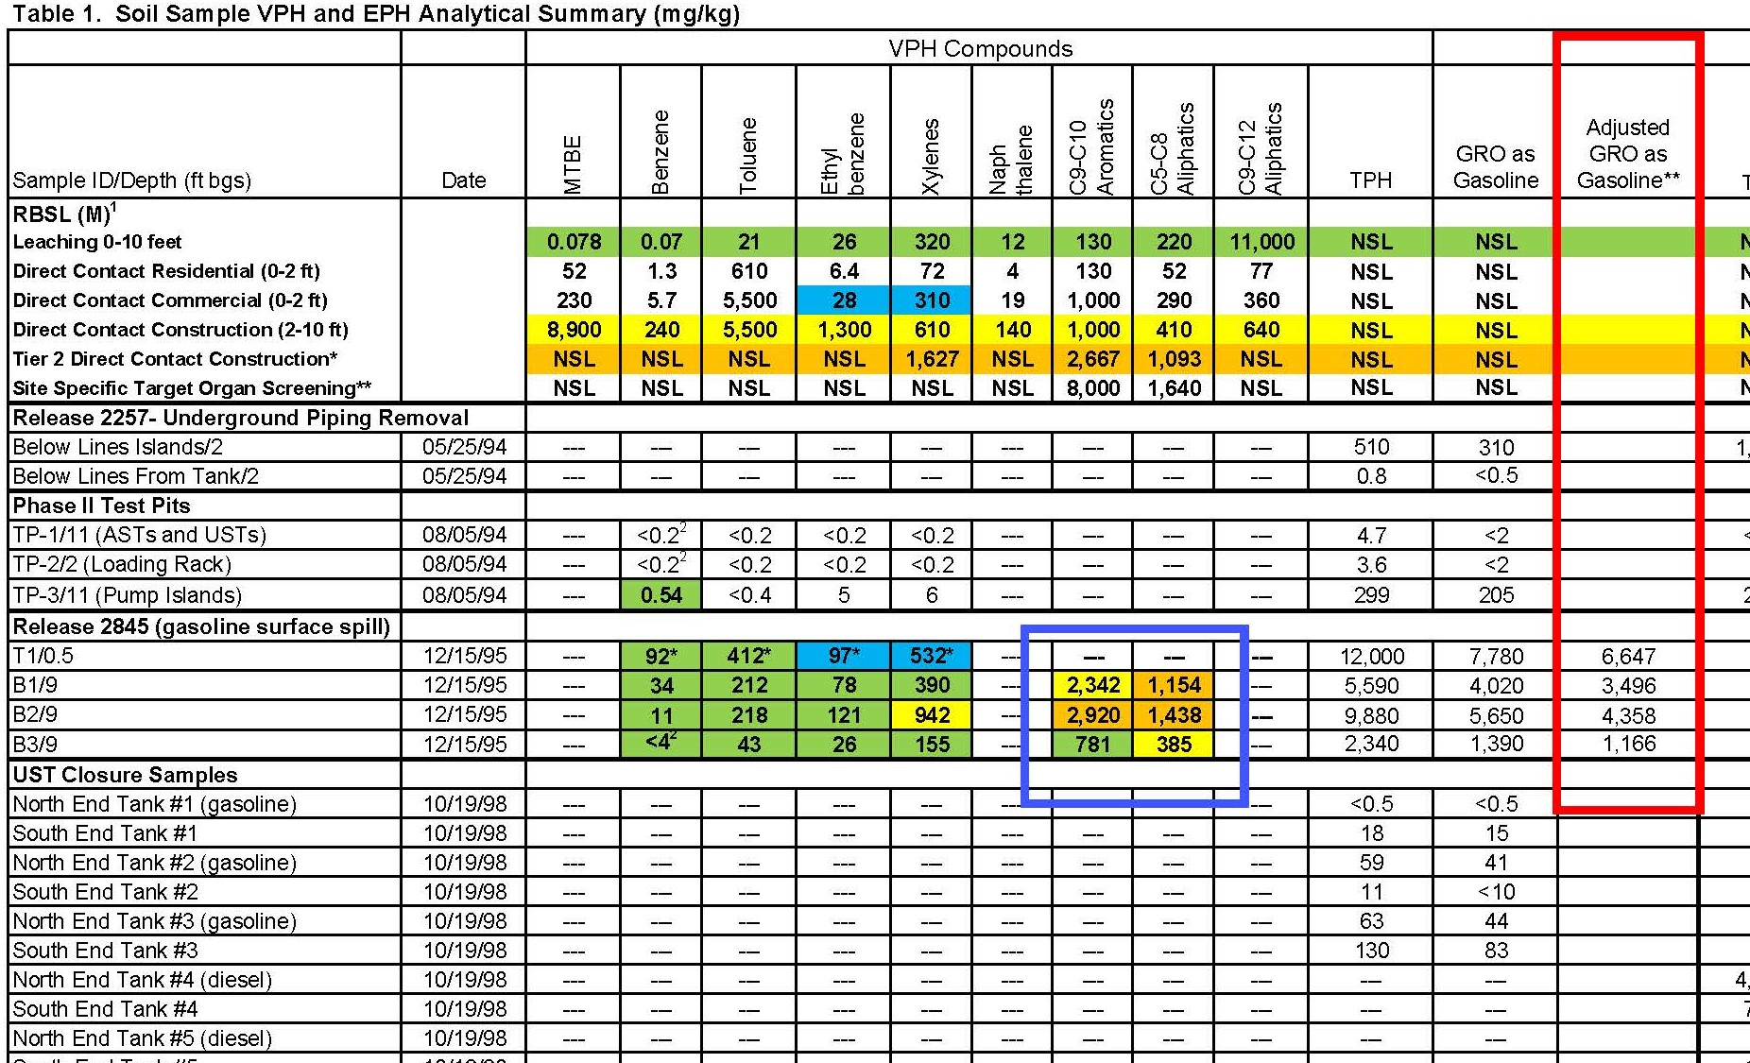

Slide 7
Suggestions for Consultant Reports to Improve Closure Process
Cumulative Soil Data Tables
Indicate Well/Boring Locations Relative to Source Area
Convert GRO/DRO Data to VPH/EPH Fractions
Compare Sample Data to Direct Contact Excavation RBSLs
Complete and Detailed Site History
Site Map with all Historical Features
Scale Bar for all Maps
Appendix with all Site Well/Soil Boring Logs

Slide 8
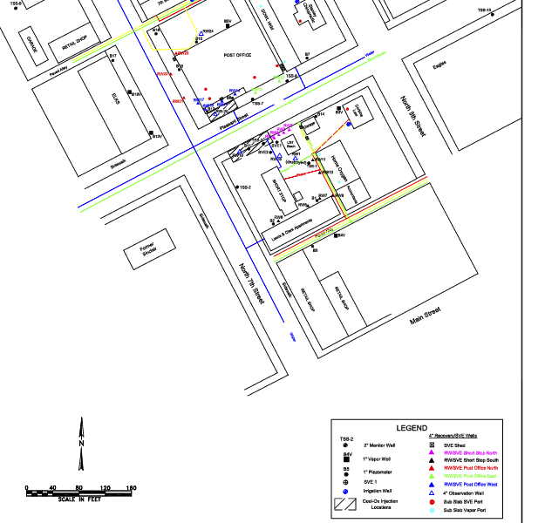

Slide 9
CONCLUSION
Complete Closure Checklist (Appendix A) in Technical Guidance 9 Before Requesting Closure
Check All Historical Soil Data And Compare Soil Sample Analytical Data to Table 4 – Master for All Potential Tier I RBSLs for Soil (Especially Direct Contact Construction 2-10 feet)
Calculate Site-Specific Tier II Direct Contact Excavation RBSLs as necessary

